Slide 1
Final Year Project
SOS Fire Alarm System
Name: Tan Kia LE id: B190139C Batch no.: Bose19c
Lecturre: MR So yong quay

Slide 2
Overview of Presentation
Introduction
Objectives, background, scope
Summary of literature review
Overview of requirement analysis and design
System implementation
Showing system

Slide 3
Intro
Fire is one of the deadliest risks that all homeowners and businesses face.
Therefore, I intend to do a web site about fire alarm system.
This system helps them save the cost and human resource for any fire alarm system department.
It also provides functions in emergency situations to help users face it more quickly and take corresponding actions in emergency situations.

Slide 4
Objectives, Background, Scope
Improve my coding level.
Less website or application is for fire alarm control system.
Focus on record and sending emergency message part.

Slide 5
Literature review: Fire Alarm System
They also have an available machine that shows details
Warning people in the building not to use the lift.

Slide 6
Overview of requirement analysis and design
Easy access factory alarm details.
Seeing Who changing status.
Record event at calendar

Slide 7
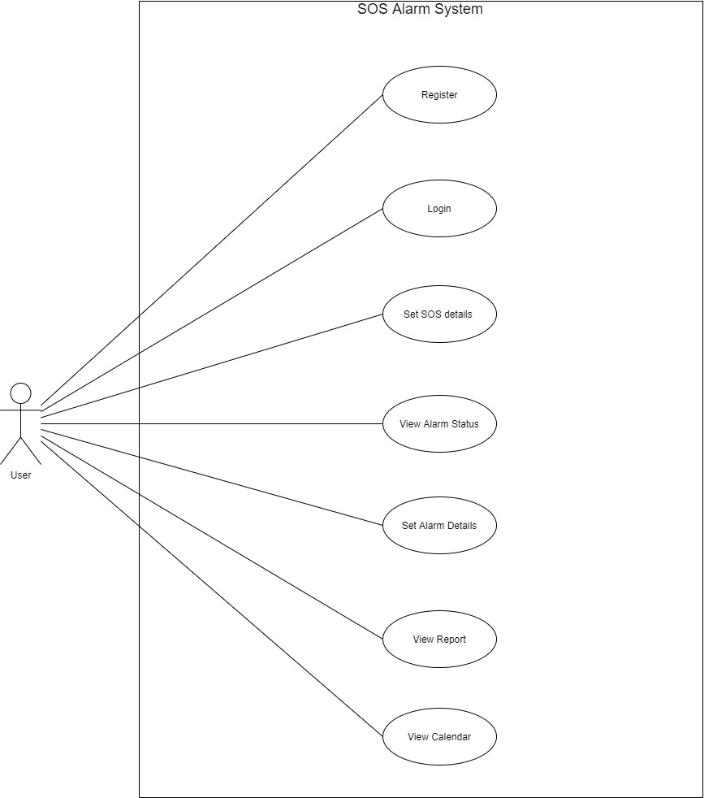
Design
Use Case:
Main Page

Slide 8
System implementation
HTML
PHP
CSS
JavaScript
Ajax

Slide 9
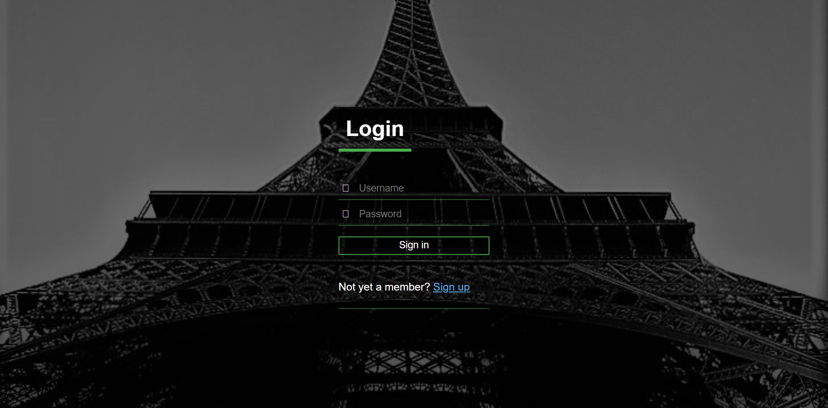
Demo System
Now I will go for demo my system.

Slide 10
QnA

Slide 11
Thank You

